Slide 2
OBJECTIVE
This presentation is intended to aid you in identifying, securing, and making the most of your shadowing experience.
Discuss its content with a faculty advisor.

Slide 3
INTRODUCTION:
Why Shadow?
By shadowing early in your medical school career, you:
Can determine if surgery is the right path for you.
Forge connections with those currently working in your field of interest.
Explore this career path prior to starting your core clerkships.
  This is especially valuable if your medical school does not have a formal preceptorship program during MS1 or MS2.

Slide 4

BEFORE YOU ARRIVE:
Research
Research the specialty in advance
  Have some questions ready as this demonstrates enthusiasm
  You DO NOT have to be an expert, but you do have to show genuine interest
Bring a small notebook and pen
  Things to ask later during down time
  Things you’d like to look up later

Slide 5

BEFORE YOU ARRIVE:
Helpful Resources
Common resources used to prepare for clerkships:
Surgical Recall: Reviewing the appropriate book chapter before each surgery can be helpful.
Lawrence's Essentials of General Surgery: Provides a great reference for specific topics to read about prior to observing a particular procedure.
Netter’s Atlas of Human Anatomy, or another anatomy text. Always know the blood supply!
Dr. Pestana's Surgery Notes: A short and to-the-point book which covers a lot of the common questions you will get.

Slide 6

BEFORE YOU ARRIVE:
Helpful Resources (cont.)
Here are additional helpful resources:
Gowned and Gloved book series (available in print, on iPhone or Kindle): Great to look up the surgery you'll be seeing right before; gives an overview of the anatomy and steps involved in each surgical procedure.
Zollinger's Atlas of Surgical Operations: Pertinent anatomy for the case.
First Aid for the Wards
First Aid for the Surgery Clerkship
Knot Tying Manual
ACS/ASE Medical Student Simulation-based Surgical Skills Curriculum

Slide 7

BEFORE YOU ARRIVE:
1st Day Attire
Dress/groom professionally.
  You may be required to wear your white coat
  Professional business attire unless otherwise instructed
  Dress pants, shirt, tie, work-appropriate dresses
  Closed toe shoes
If unsure, overdress the first day; then scale back to align with others, or as instructed.
Notes:
I think the suit is over-dramatization. Would use a med student as a real example
Updated with new photo.

Slide 8

BEFORE YOU ARRIVE:
Tips for Operating Room Attire
For long procedures, some medical students have found compression socks to be helpful.
  Available for purchase at most drugstores
Comfortable shoes (e.g., sneakers, clogs, etc.) are a must.
Notes:
Shoes: e.g. sneakers, clogs, etc
Updated to include sneakers, clogs, etc.

Slide 9
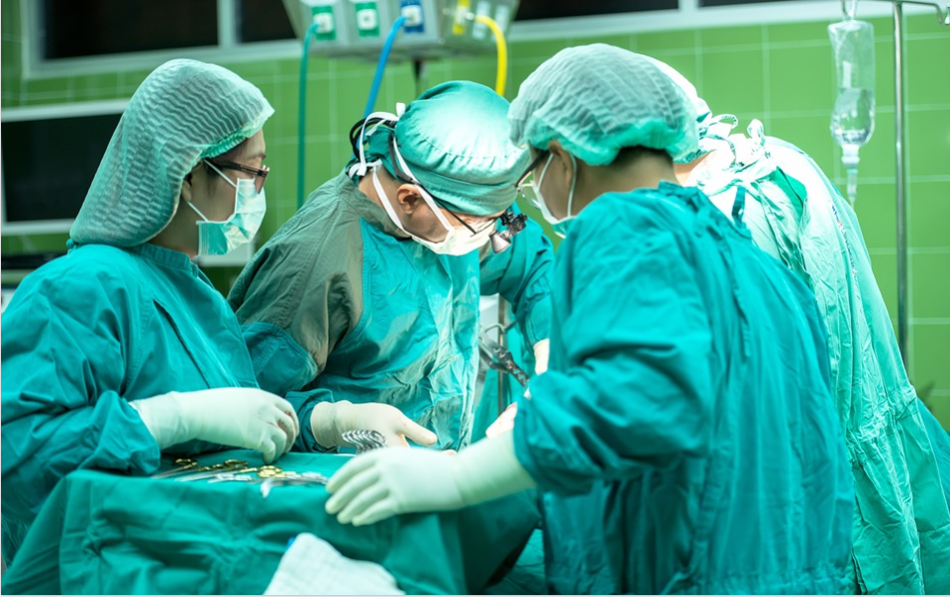
BEFORE YOU ARRIVE:
Shadowing in the OR
Review videos for gowning and gloving.
Wear scrubs, mask, hair cover, booties, and eye protection (e.g., face guard, disposable glasses, or your own glasses) in the OR.
  Pro Tip: tape the top of your mask to the bridge of your nose to keep your glasses from fogging.
Ask where to stand for best views. Don’t contaminate the sterile field!
Notes:
Would get a close up picture of someone with all the appropriate garb on
Would not expect to scrub – need to ask where to stand, watch out for sterile draping and instruments. Get steps or stools to help see. Maybe and in-field camera.
If scrubbing, get gloves to scrub tech.
Image updated; text edited to include wear to stand, do not contaminate the sterile field

Slide 10

BEFORE SURGERY STARTS:
Don’t forget your bioneeds breaks
Before you walk into any OR, make sure to:
  Eat
  Hydrate
  Use the restroom
Pro Tip: During long procedures, there may be a break while waiting for pathology or radiology. Use this opportunity to take a quick break even if you don't think you need it.

Slide 11

BEFORE SURGERY STARTS:
Who is the patient?
Ask your Attending or Resident to brief you on the following four items:
The patient's history and indication for surgery
Pre-operative labs
Facts about the disease process (epidemiology, pathophysiology, etc.)
The basic steps of the procedure, and the relevant anatomy
This will ensure that you maximize your learning during the case, and will orient you to the types of questions that the Attending or Resident may ask you.

Slide 12
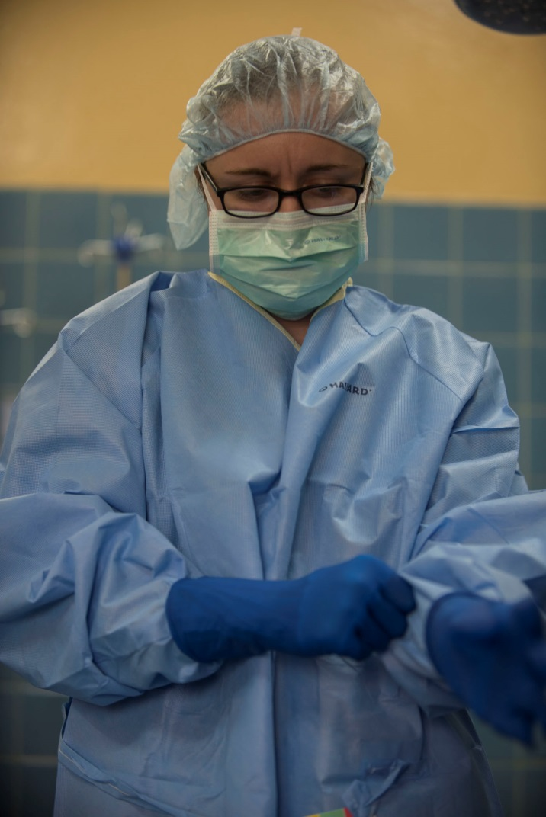
IN THE OR:
An aside about contamination
There is NO SHAME in admitting that you have accidentally contaminated yourself.
This will inevitably happen at some time
  Yes, even to attending physicians
Be honest and upfront with the scrub tech; you will stay on their good side this way
Image Courtesy of U.S. Army Africa, taken by Staff Sgt. Shejal Pulivarti

Slide 13

“DAY OF” ADVICE:
First Things First
When you get into the OR:
Introduce yourself to the circulating nurse.
Write your name on the whiteboard, along with your year in medical school.
    If you will be scrubbing on the surgery, add your glove size or pull out your gloves for the scrub nurse.
  Wear your badge in the V-neck of your scrubs or your front pocket.
    It lets everyone know who you are.
    It ensures that you always have your badge.

Slide 14

“DAY OF” ADVICE:
Surgery is a Team Sport
While shadowing, your primary duties are to watch and learn (and not contaminate the sterile field).
However, you may be asked to help, e.g., running errands.
If you’re asked to help, do it and do it well!
Image Courtesy of www.lumaxart.com/
Notes:
Also getting the bed, changing the sheets,
Not the things listed here are duties for a shadower.
Updated to describe primary duties of a shadower.

Slide 15

“DAY OF” ADVICE:
Ask Questions during Down Time
Asking questions when things are busy can take time away from patient care, and can frustrate other members of the team.
Suggestions for questions to ask during down time:
Physician lifestyle
Average hours per week spent at the hospital
What is call like for this specialty
What types of procedures do they routinely perform
Training required (fellowships, additional certifications)
Job market/growth trends
Benefits of academic vs. community practice

Slide 16
“DAY OF” ADVICE:
Not just the OR
Surgeons do things outside the operating room, too, which offer other opportunities for shadowing.
These include shadowing in the clinic, seeing the patient pre-operatively in the PACU, asking to see the patient in follow-up clinic after the surgery is done, rounding with the team, attending tumor boards and conferences, etc.
Seeing all the things a surgeon does can help you decide if surgery is the right career for you!

Slide 17

AFTER YOU ARE FINISHED
Write a thank you note!
  Depending on the formality of the experience, choose handwritten or email.
  This could be a good time to
    indicate that you would like to do a more formal rotation in the future, or
    ask for a letter of recommendation for residency.

Slide 18
How to Create a Shadowing Program at Your Medical School
ADDITIONAL SUGGESTIONS

Slide 19

1st STEP:
Talk with the Dean of Students
If your medical school has an affiliation with a teaching hospital, formalizing a shadowing program can provide an efficient method for shadowing a wide range of providers.
  1st Step: Talk with the Dean of Students at your medical school.
  They may have previous experience or knowledge about what has been tried or done in the past, if anything.
  They may provide helpful insight about any legal hurdles to be addressed first.

Slide 20

  2nd STEP (with Dean approval):
  Determine Hospital-Specific Requirements
    2nd Step: Determine the hospital-specific requirements to be met by the shadowing medical students.
      May include ID badges, special training, legal forms to sign, etc.

Slide 21

3rd STEP:
Create and Advertise
  3rd Step: Create the shadowing program and promote it with your classmates.
  If the concept is brand new, consider starting small – choose one clinical department you’re familiar with (e.g., Pediatrics, IM, etc.).
  Be flexible – depending on the department and resident/attending preference, the shadowing opportunities will range in scope and involvement.
  Get residents on board! They’re closer in age and training, and it is likely that they won’t be evaluating you directly.

Slide 22
4th STEP:
Specify the Dates/Times
4th Step: E-mail the link to a Google spreadsheet allowing students to sign up for shadowing time-slots. (See next slide for example.)
  Specific instructions may also be included (what to wear, where to go and meet the resident/attending, etc.).
Once students sign up for a slot, encourage them to reach out to the resident/attending beforehand to remind them about the shadowing arrangement and to re-confirm .
Feel free to share this PowerPoint.

Slide 23
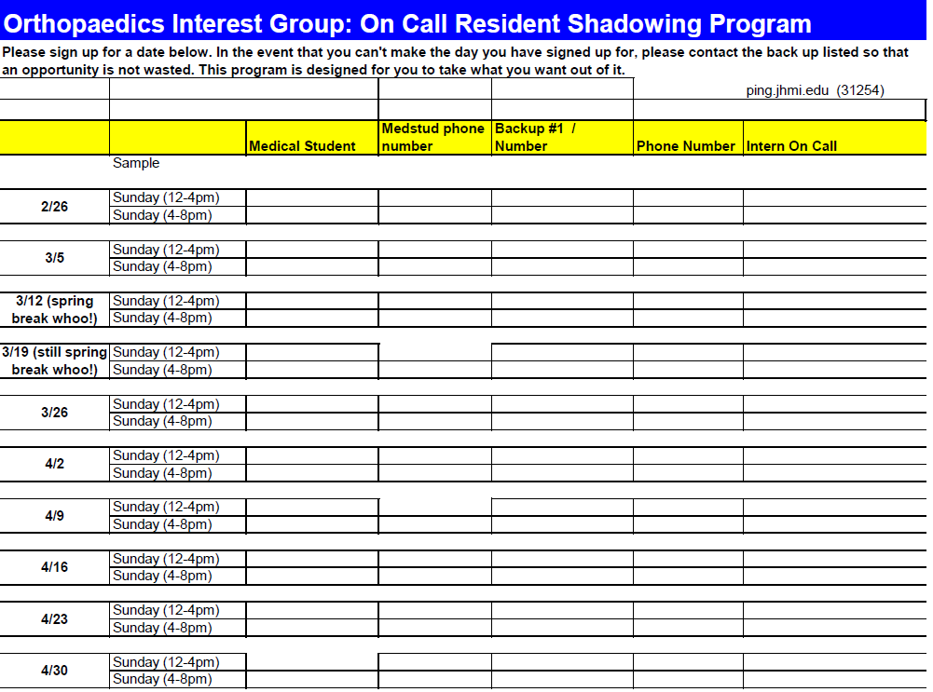
SAMPLE SCHEDULING SPREADSHEET

